Slide 1
Web Development Presenting Traveling site
Harsh Grewal
Roll No:226005
1st SEM BTech(CST)
St.Andrews Technology and Managment
HTML,CSS

Slide 2
Index
Introduction.
Objective.
Implementation Work.
Application of software tools.
Conclusion

Slide 3
Introduction
There are eleven html files that make this a proper website.
Content of the repository-
HTML (Hyper Text Markup Language)
CSS (Cascading Style Sheets)
Images
Videos

Slide 4
Objective To design a website by which user can book traveling packages around the world and booking hotels, flight, and holiday packages.
User can use this site for booking hotels and flights.
User have to login for good experience and many others beneficials.
On our home page user can see best offers for holiday packages.
In holiday package user can select activity as per his/her wish where user is shown different activity with details and prices.
On the holiday package page the user can watch a video and read information about that destination.

Slide 5
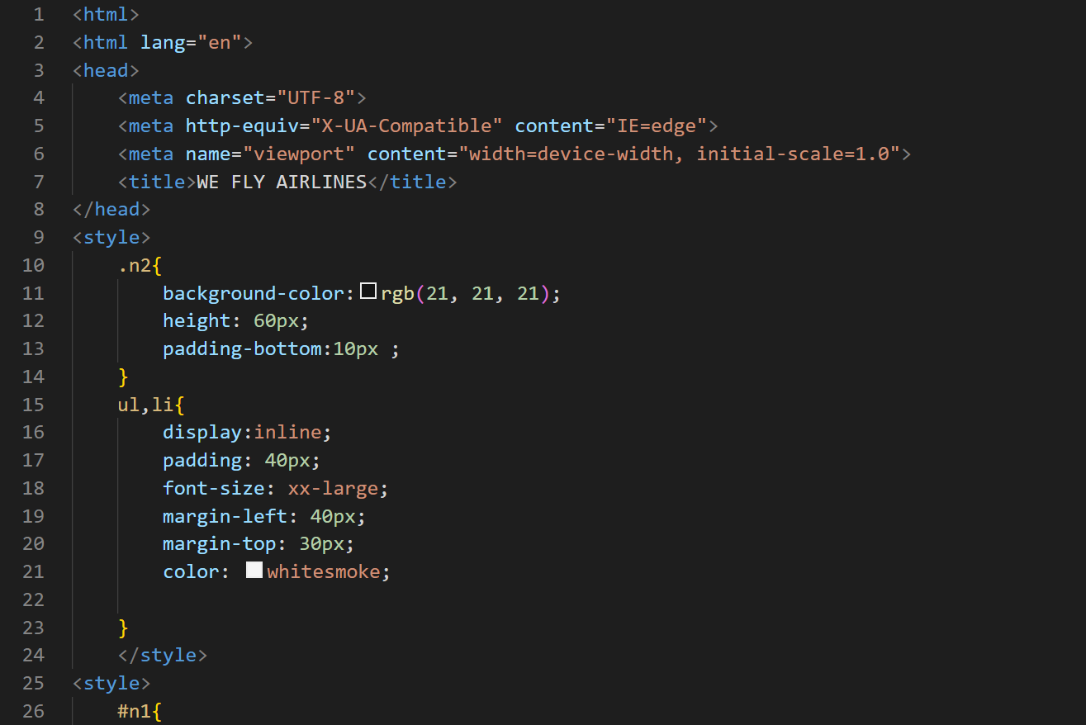
Implementation Work
Source Code of Home page
Fly.html (Home page)
External
CSS

Slide 6
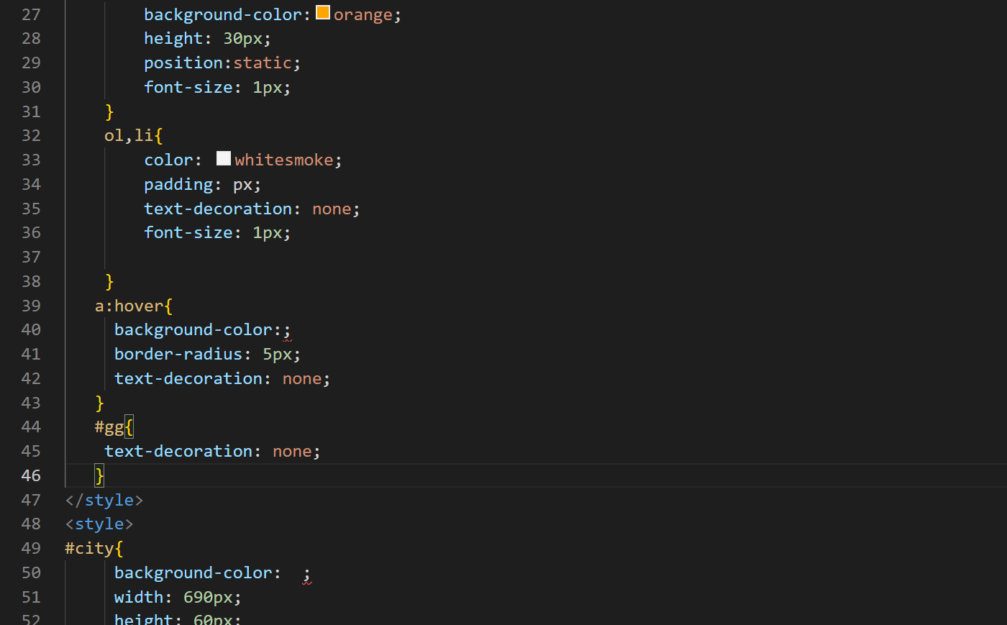
CSS

Slide 7
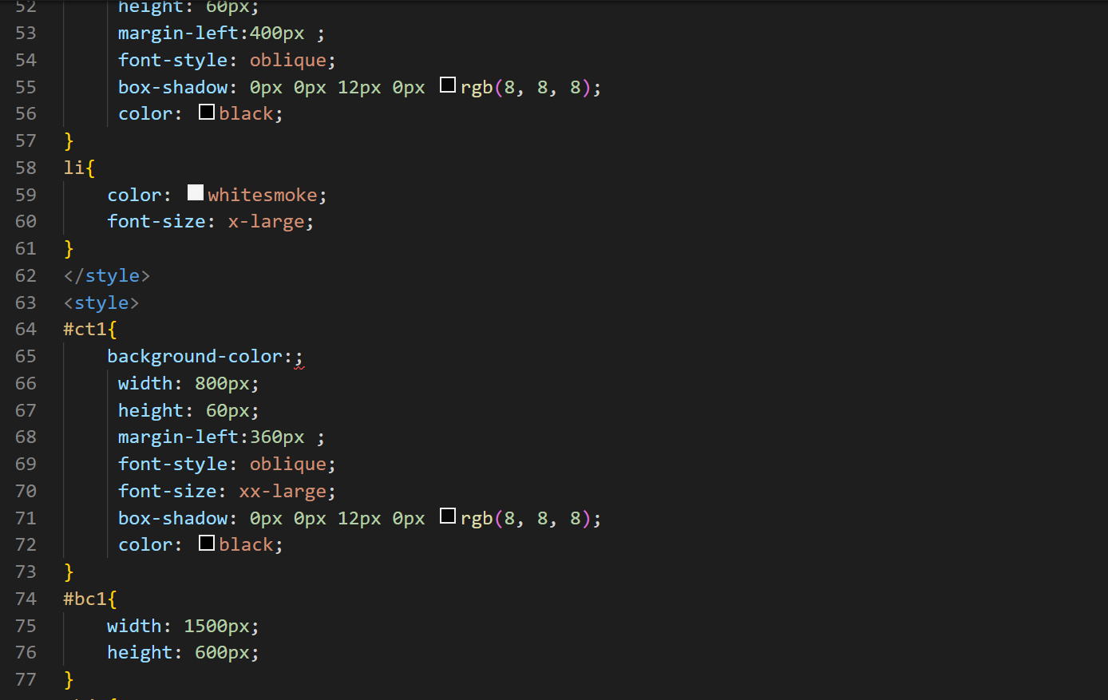
css

Slide 8
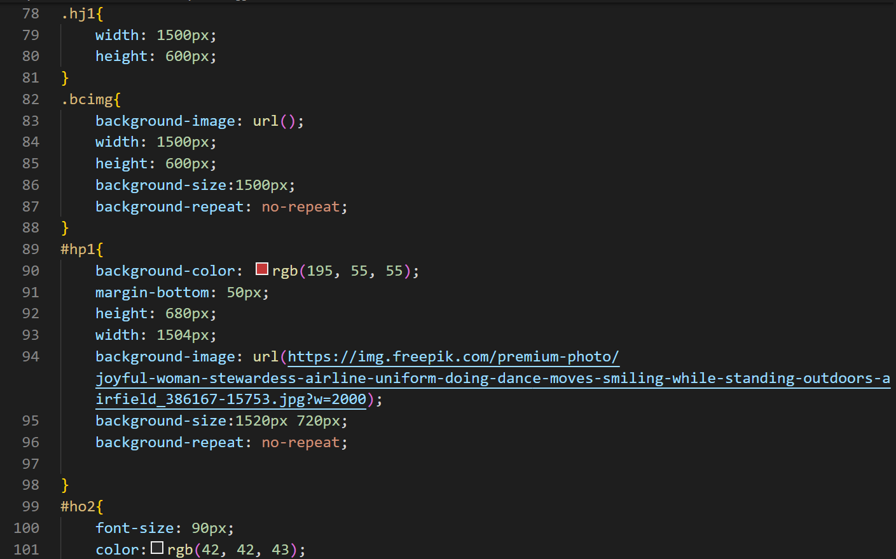
css

Slide 9
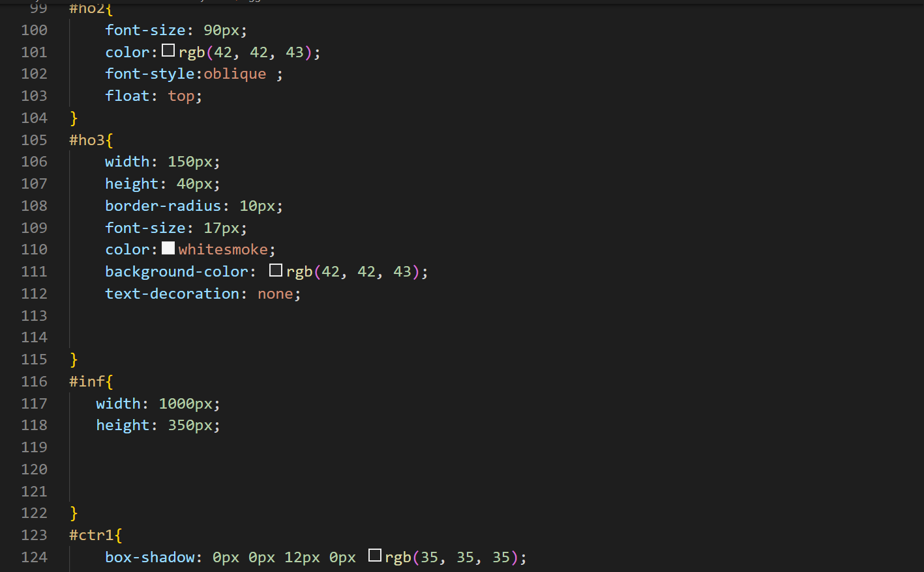
CSS

Slide 10
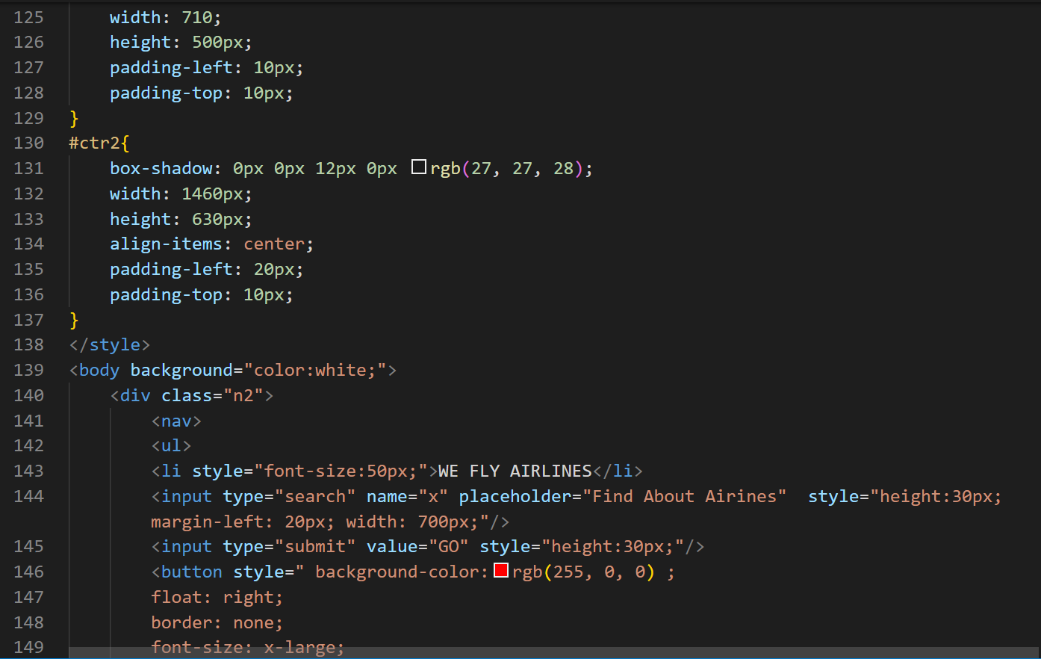
CSS
HTML

Slide 11
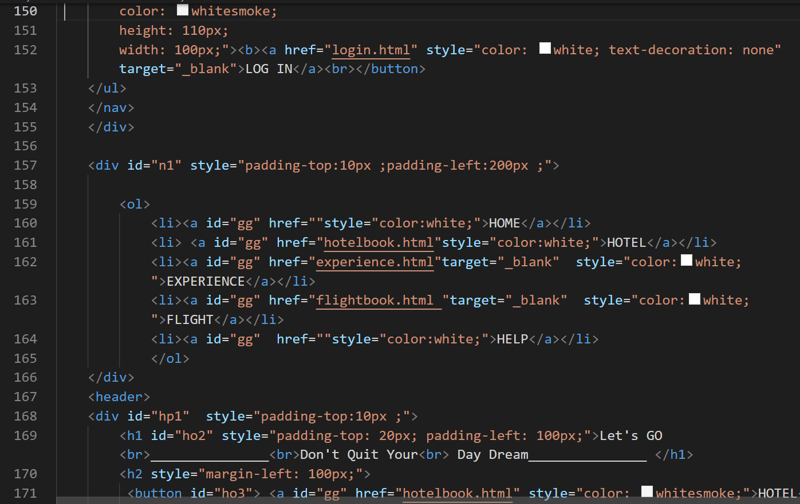

Slide 12
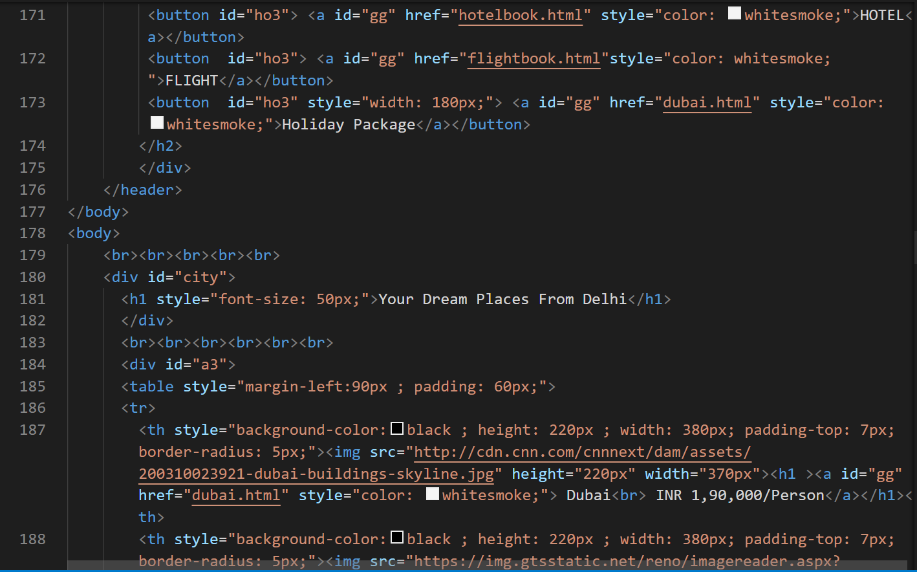

Slide 13
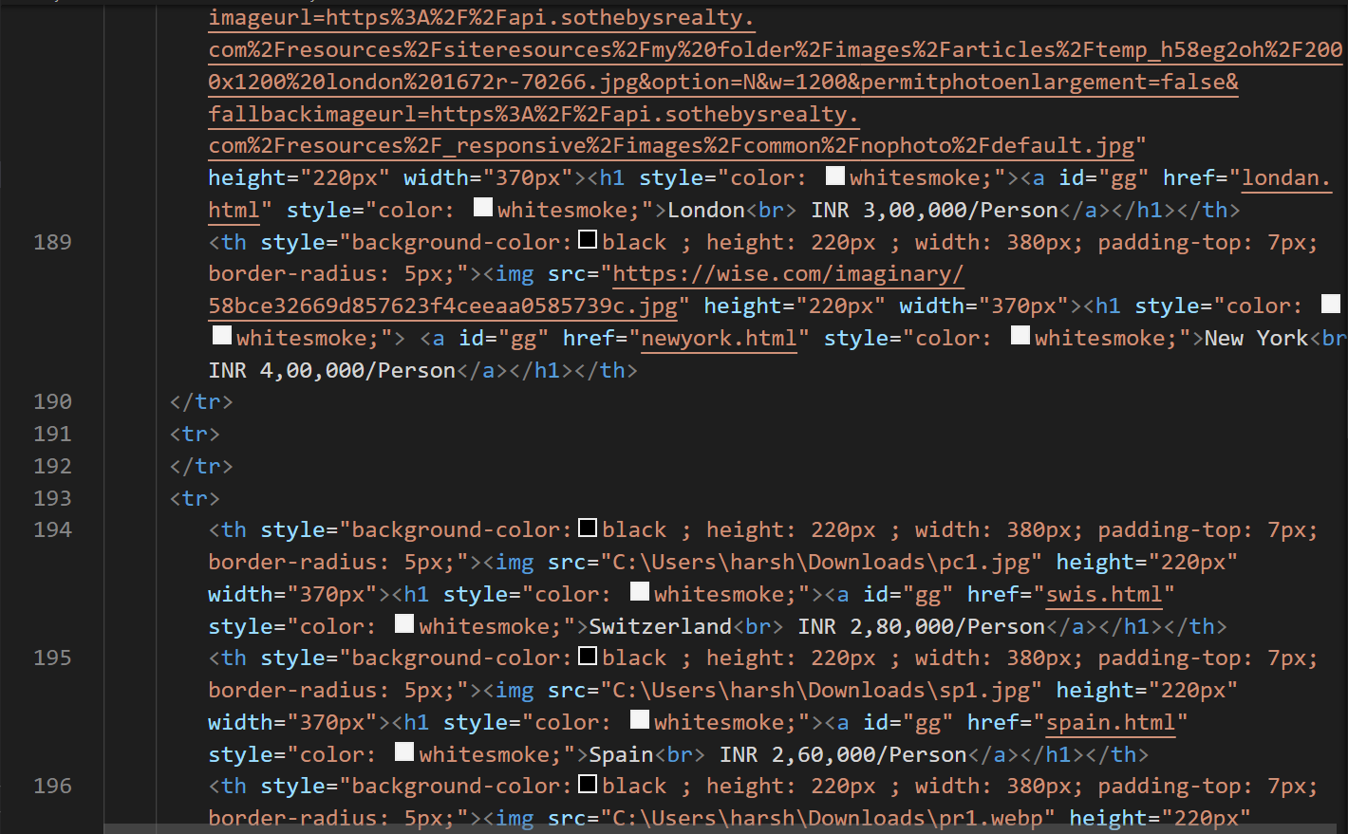

Slide 14
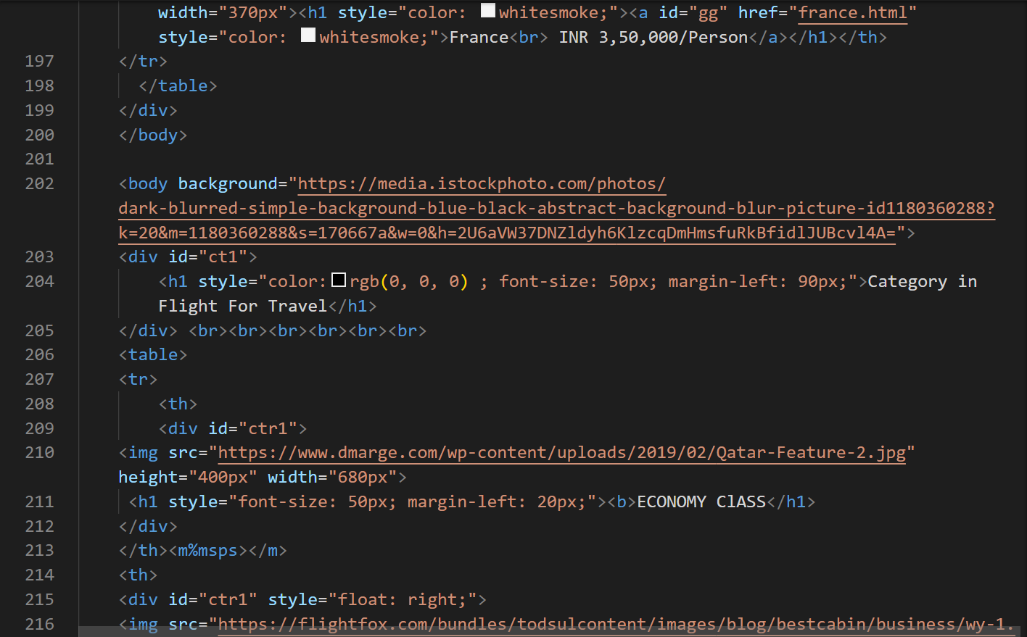

Slide 15
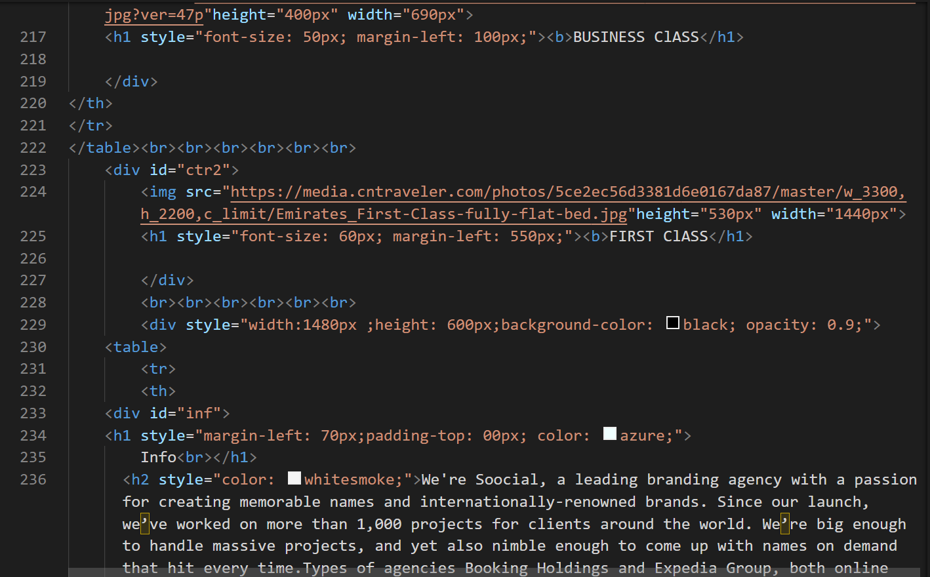

Slide 16
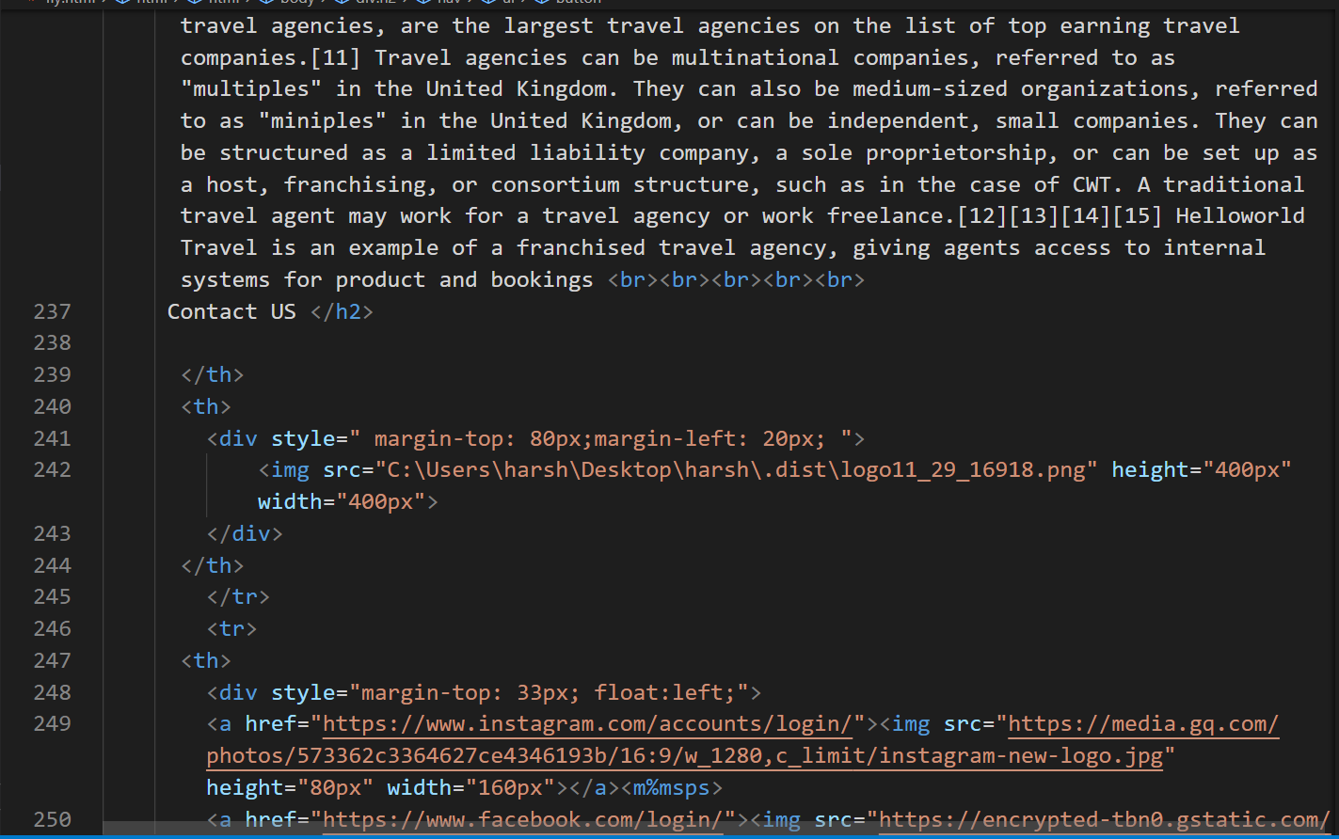

Slide 17
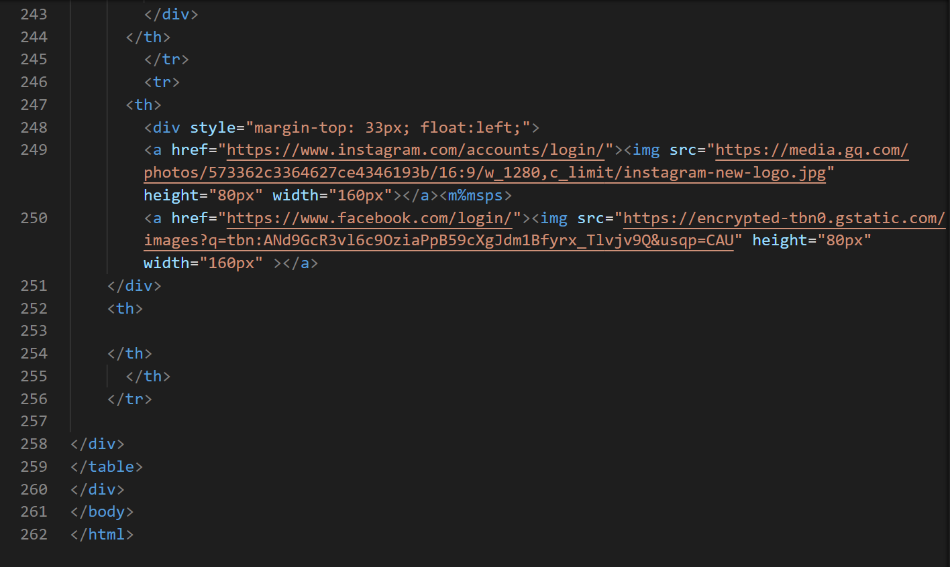

Slide 18
Application of software tools Tools used:
Vs code: Visual Studio Code, also commonly referred to as VS Code, is a source-code editor made by Microsoft with the Electron Framework, for Windows, Linux and macOS
Clipchamp : App used for video or photo editing
Chrome: Chrome bowser used for show output of code (website).

Slide 19
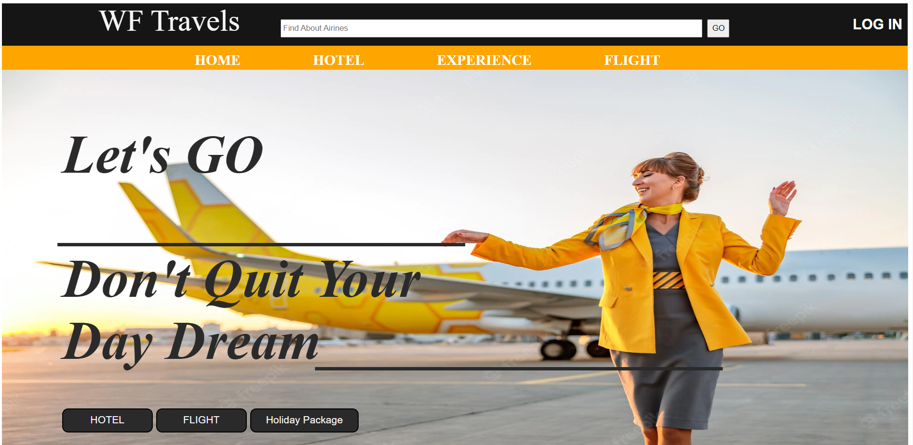
Conclusion
Simple images to show home page of website

Slide 20
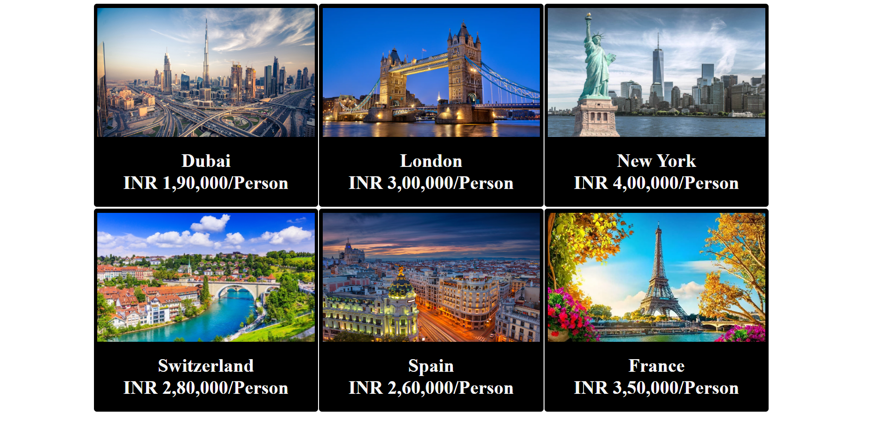

Slide 21
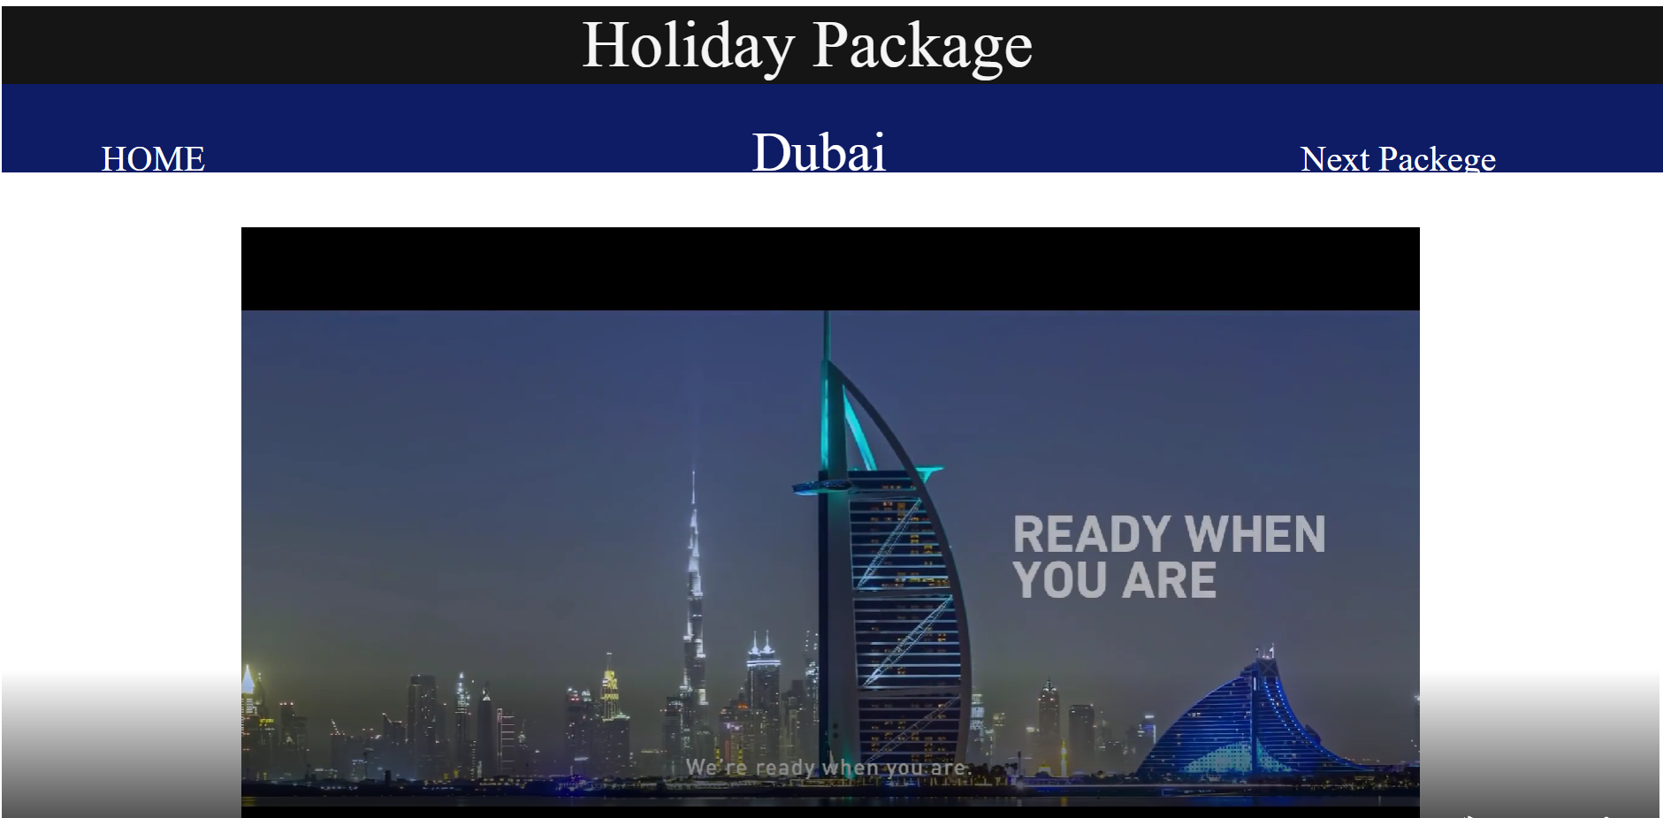
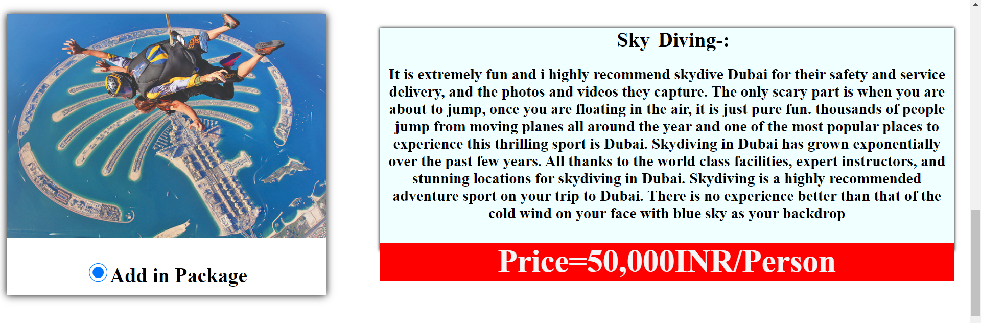
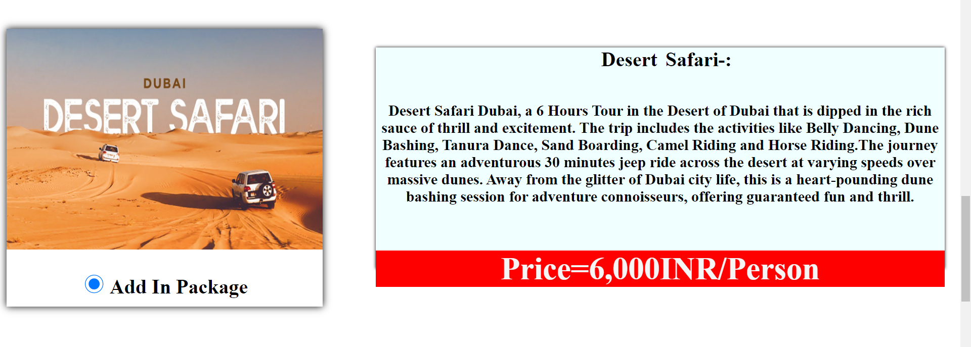
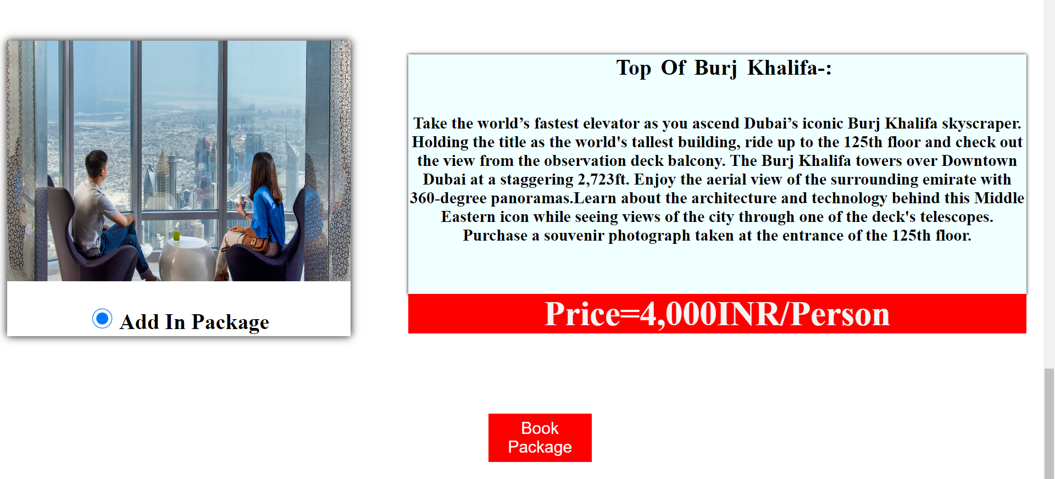

Slide 22
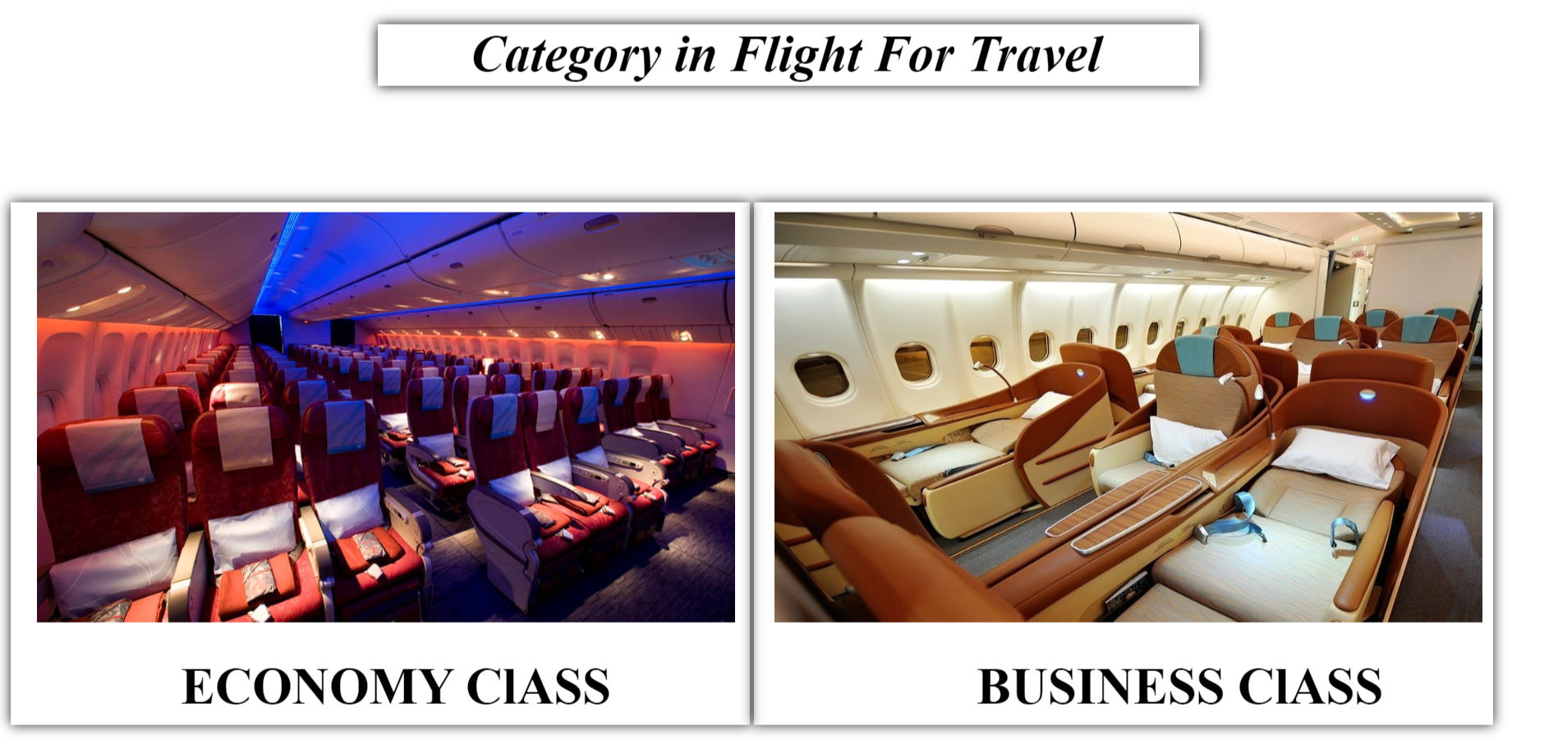

Slide 23
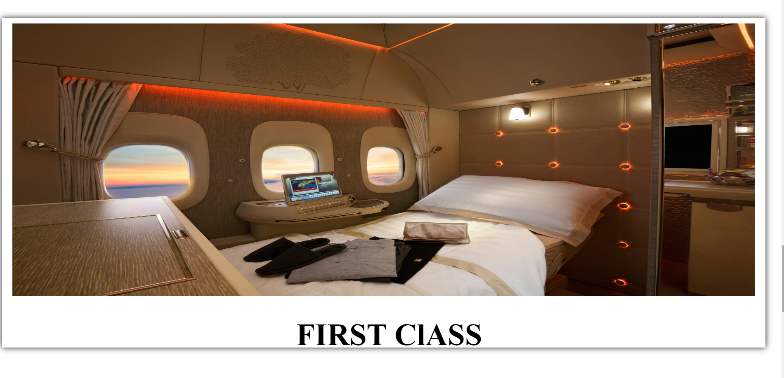

Slide 24
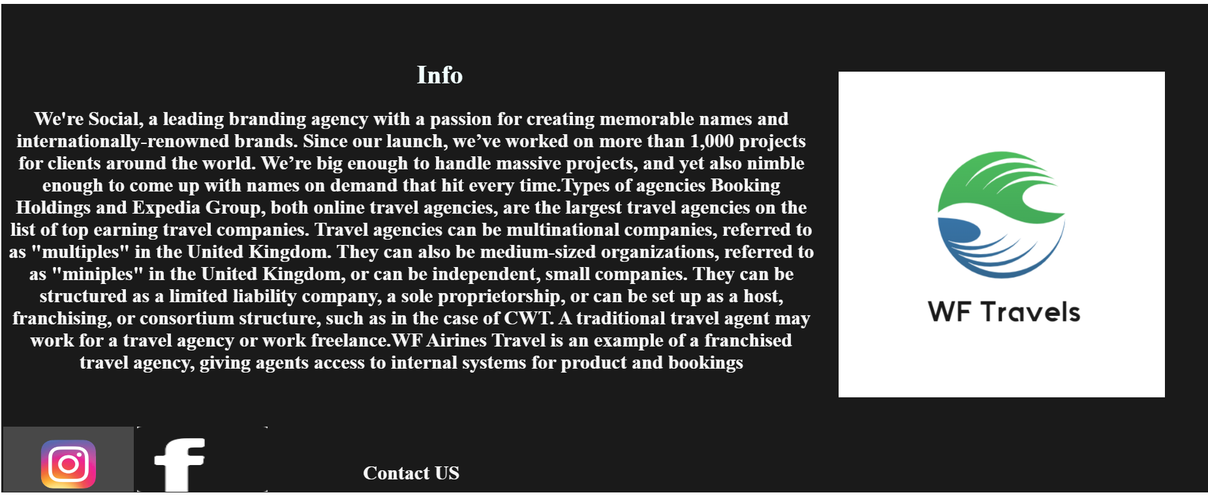

Slide 25
Thank to all

